Slide 1
Introduction to ML Part 2
Explore ML
Notes:
This session will go into a little more detail about machine learning. It is helpful if you have already completed some introduction to machine learning but if you have any questions please ask.

Slide 2
What is Machine Learning?
Notes:
Let's review. How would you explain machine learning?
Answers could include (shown on the following slides):
Machine learning is a specific field of AI where a system learns to find patterns in examples in order to make predictions.
Computers learning how to do a task without being explicitly programmed to do so.

Slide 3

Machine Learning systems take inputs (data) to make useful predictions and decisions about previously unseen pieces of data.
PROPRIETARY + CONFIDENTIAL
ML Extended
Notes:
Here's one definition.

Slide 4
Machine learning is a specific field of AI where a system learns to find patterns in examples in order to make predictions.
PROPRIETARY + CONFIDENTIAL
ML Extended
Notes:
Here's another definition.

Slide 5
Computers learning how to do a task without being explicitly programmed to do so.
PROPRIETARY + CONFIDENTIAL
ML Extended
Notes:
And another definition.

Slide 6
Machine Learning systems might:
Label or classify data
Predict numerical values
Cluster similar pieces of data together
Infer association patterns in data
Create complex outputs
Notes:
Here is a list representing some of the things a machine learning system can be trained to do.
Question: What are some examples of features and products that you assume use machine learning? How could you tell it was ML?

Slide 7
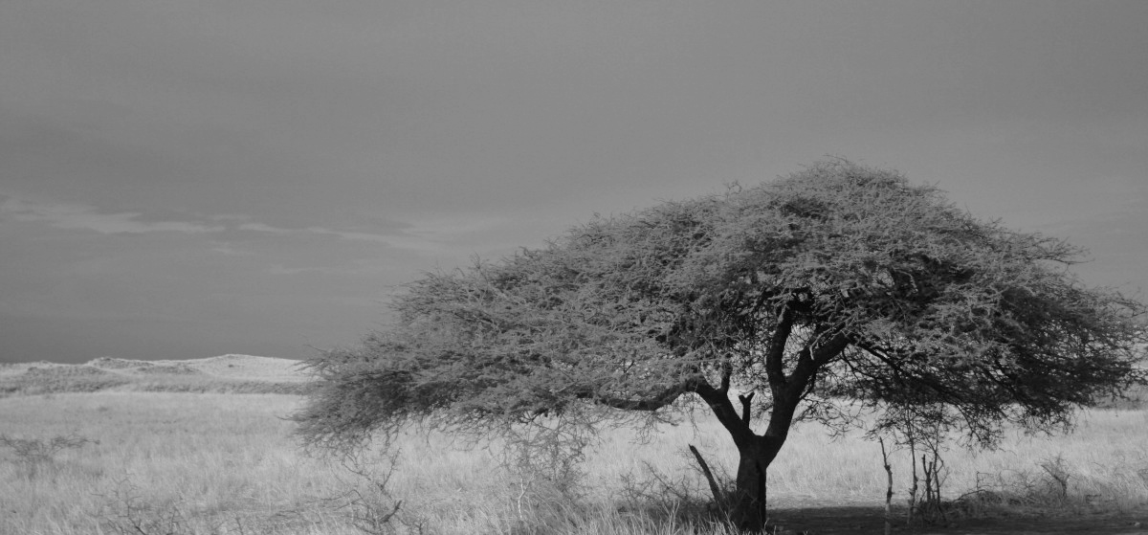
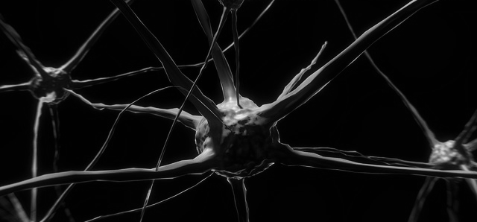
Examples of Machine Learning
Read a couple of news articles involving applications of ML.
Would a traditional programming solution be more efficient?
Could a human perform the same task in less time?
What are the benefits of a Machine Learning model in these instances?
AI and drone-based imagery improve power to survey cryptic animals
Machine Learning could be used for early dementia diagnosis
Notes:
Use your computer and go to news.google.com or some other search engine to find and read a couple of online news articles involving applications of ML. Note: Sometimes news stories refer to ML as artificial intelligence (AI).
While you are reading, think about these questions.
Give learners 20 minutes to complete this task.
Serengeti image from https://pxhere.com/en/photo/831281 CC0 Public Domain Free for personal and commercial use No attribution required
Brain image from https://pixabay.com/illustrations/nerve-cell-neuron-brain-neurons-2213009/ Pixabay License Free for commercial use No attribution required

Slide 8







Machine Learning
Supervised
Unsupervised
Model is trained on labeled data
Model learns patterns from unlabelled data.
stop_sign_1
stop_sign_2
stop_sign_3
stop_sign_4
Notes:
Machine learning looks for patterns in data.
The majority of ML applications today are supervised learning where labeled data is used to teach the model. This includes tasks like classification and regression.
Supervised machine learning is analogous to a student learning a tricky maths concept by studying a set of questions and their corresponding answers. After mastering the mapping between questions and answers, the student can then provide answers to new (never-before-seen) questions on the same topic.
The signs on the left are labeled data so a supervised machine learning system could learn from these labels what stop signs around the world look like.
The signs on the right are unlabeled data. Even the sign with the word stop because labeled data requires a human's rating to indicate what it is.
Images:
https://wikipedia.org/wiki/Stop_sign
https://wikipedia.org/wiki/Comparison_of_European_road_signs

Slide 9
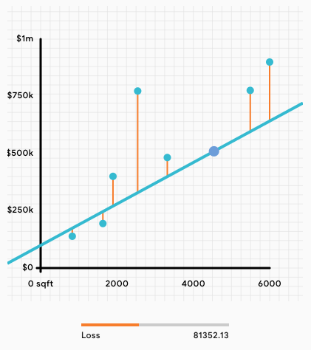
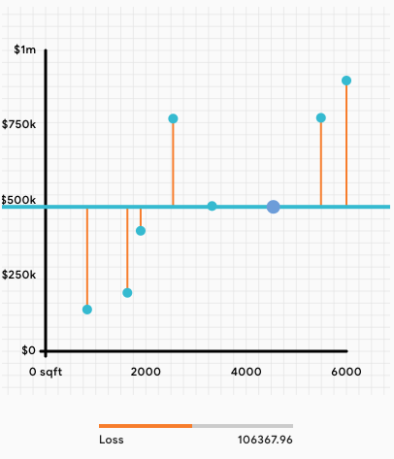
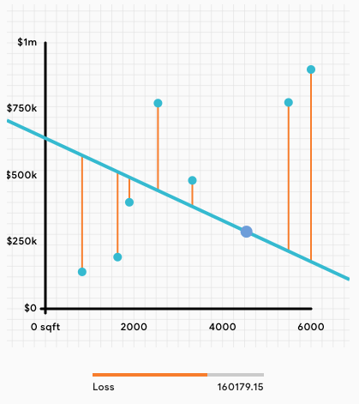
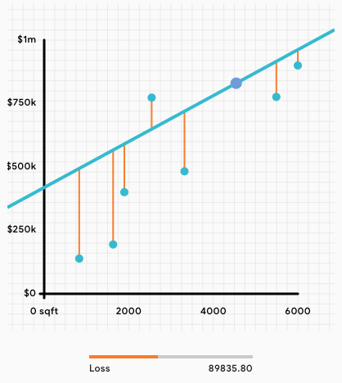
Loss
Notes:
In the previous slide, I said supervised machine learning is analogous to a student taking a test. Let's say I created the 4 machine learning regression models above. Which one is the best?
It depends on your goal and what variable you are trying to optimize for. To grade how well a model is doing on its test, machine learning practitioners measure the distance between the model's prediction (indicated in these graphs by the blue line) and the example data. This is known as loss.
[Click to animate slide]
With the loss displayed. Which model is best at achieving the goal?
[Click to animate slide]
Model #3 has the lowest loss which indicates this model is best at achieving the goal.

Slide 10
Features
Predicting the Price of a House
Location
Number of bedrooms
Size of property
Number of light switches?
Color of house?
Notes:
Features are the variables which distinguish one example from another. They tell the machine learning model what parts of the data to look for patterns for achieving the goal.
The first three variables would probably help the model determine a home price the other two probably would not. So lots of data is crucial to a machine learning system but it needs to be helpful and relevant data. Though you never know until you experiment to see what variables truly make an impact.

Slide 11
Features
Recommending which video a user should watch next
Topic
Popularity of a video/Number of views
Creator of video
Length of video?
Age of video?
Notes:
Ask learners to come up with a list of features which might be helpful in recommending the next video to watch.
The last two might turn out to be very important variables, there's no way to know unless you experiment.

Slide 12
Checkpoint on Learning
A baker would like to optimize pricing of cakes in their bakery depending on previous pricing, cost to make, and time of year.
What about the scenario make it suitable for ML?
What is the benefit to the business?
Would a human perform the job better?
What are the inputs to the system?
How could the ML model go wrong?
Notes:
What about the scenario make it suitable for ML?
multiple variables, potentially lots of data examples, a goal to optimize
What is the benefit to the business?
the business will benefit by finding the ideal price for their cakes accounting for multiple variables.
Would a human perform the job better?
Data analysis could find the optimal value but would need to be continuously adjusted as new data comes in.
The more variables that play a role, the more effort would be needed.
What are the inputs to the system?
Previous prices
Cost to make
Time of year
How could the ML model go wrong?
If there was not enough data
It was biased in some way (e.g. only trained for certain times of year)
It was mislabeled
Stretch question: Why might time of year be a factor in the price of cake?
A: Wedding season! Because demand is high during the summer a baker can charge more for cakes.
(Other seasonal answers, such as a holiday time, also work)

Slide 13
Checkpoint on Learning
An ocean conservationist would like to track fish populations over time.
What about the scenario make it suitable for ML?
What is the benefit for the organization?
Would a human perform the job better?
What are the inputs to the system?
How could the ML model go wrong?
Notes:
What about the scenario make it suitable for ML?
Using prior examples to train a system to recognize new examples.
Lots of examples over time
What is the benefit for the individual?
Reduce time labeling photos of fish
Could identify issues more quickly
invasive species
reduction in population
Would a human perform the job better?
It would be a very slow process and even experts make mistakes and have to refresh their knowledge
What are the inputs to the system?
Type of fish
Region found
Time of year
Number of fish
How could the ML model go wrong?
If the data is not diverse enough, a fish could be misclassified
Fish are not homogeneously distributed, the count could be off depending on the sampling.
Stretch question for 2: What would happen if the conservationist found a fish the model had never seen before?
A: ML models will always provide an answer- even if it is totally wrong!! This is why (at least for the time being) ML models still need humans to check up on their work.

Slide 14
Checkpoint on Learning
An online brand influencer wants a model that can predict the number of ‘likes’ that a particular post may get.
What about the scenario make it suitable for ML?
What is the benefit for the business or individual?
Would a human perform the job better?
What are the inputs to the system?
How could the ML model go wrong?
Notes:
What about the scenario make it suitable for ML?
Lots of examples of data
Can run experiments to see which variables have an effect
What is the benefit for the business or individual?
The model can get the most visibility for their customer
Would a human perform the job better?
With so many variables, a human could get a sense for optimal times for a specific situation but it would become complex if the product, influencer, audience, etc were changed
What are the inputs to the system?
Potential variables could include: Time of day, person posting, brand, product, social network
How could the ML model go wrong?
If trained only for a specific type of post, product, etc it might not generalize to another scenario
If the training data is for the wrong demographic (gender, age, marital status, etc) the patterns might not be relevant.

Slide 15
Checkpoint on Learning
Create your own scenario
What about the scenario make it suitable for ML?
What is the benefit for the business or individual?
Would a human perform the job better?
What are the inputs to the system?
How could the ML model go wrong?
Notes:
Give learners 2 minutes to create their own scenario.
Have them turn to the person next to them and present the scenario.
The other person has 2 minutes to answer the questions on the slide.
Learners swap roles and repeat steps 2 and 3.

